Slide 1
WEB APPLICATION PROJECT TORE - LEARNING MANAGEMENT SYSTEM

Slide 2
Motivation
Using Learning Management Systems in education offers a smart alternative to educational institutions and allows instructors to deliver customized content, leverage various instructive models, and engage their students much better than previously possible.
What are the benefits?
Centralized Learning
Unlimited Customization
Tracking & Reporting
Enables Collaboration
Supports Active Learning
The benefits of learning management systems in education are compelling enough to make educational institutions around the world take notice, appreciate and start implementing them.

Slide 3
Overview
To create a central platform where students and teachers can share study materials and inquiries, TORE- Learning Management System allows students and teachers to interact in a simple and convenient manner.

Slide 4
Team - TORE
Saad Ahmed
Overall backend design
Abdul Moeed Rao
Design and implementation of Login portion.
Sepide Bahrami
Design and implementation of Database
Dodo Khan Soomro
Abdul Rehman
Aliia
Iyad
Muzammil
Marit
Design, implementation of Admin & Student portion
Equally contributed in Login and Admin portion
Design and implementation of Teacher portion
Design and implementation of Student portion
Equally contributed in implementation of database and Student portion
Equally contributed in Teacher portion
Implementation of Student portion
Assisted in front end design of admin portal dashboard
Implementation of Admin & Teacher portion

Slide 5
Structure
Admin
Approve Student Registrations
Add Teachers
Teacher
Post Teaching Material
Respond to Students Queries
Student
Register in System
Observe Learning Material
Add Subjects
Assign Subjects
Manage Database
Manage Students
Post Queries
Request for a Course

Slide 6

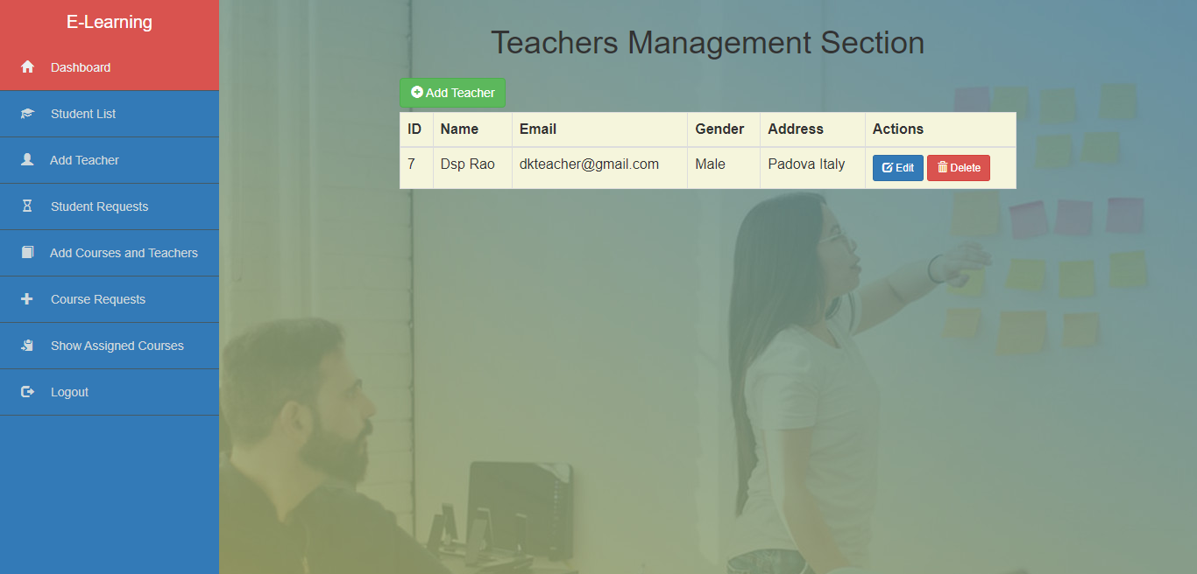
Admin
Login / Authentication Process
Default Admin is registered in database
Administrator can add the teacher by adding its relative fields to database after which teacher can access its account
All registration requests from students who sign up for the system will be approved by administrator after that students can access accounts
Add / Assign Subjects
Administrator is authorized to add subjects and their descriptions
Administrator can assign subjects to teachers manually
All subjects assigned to teachers and vice versa can be viewed and managed by administrator
Continue

Slide 7
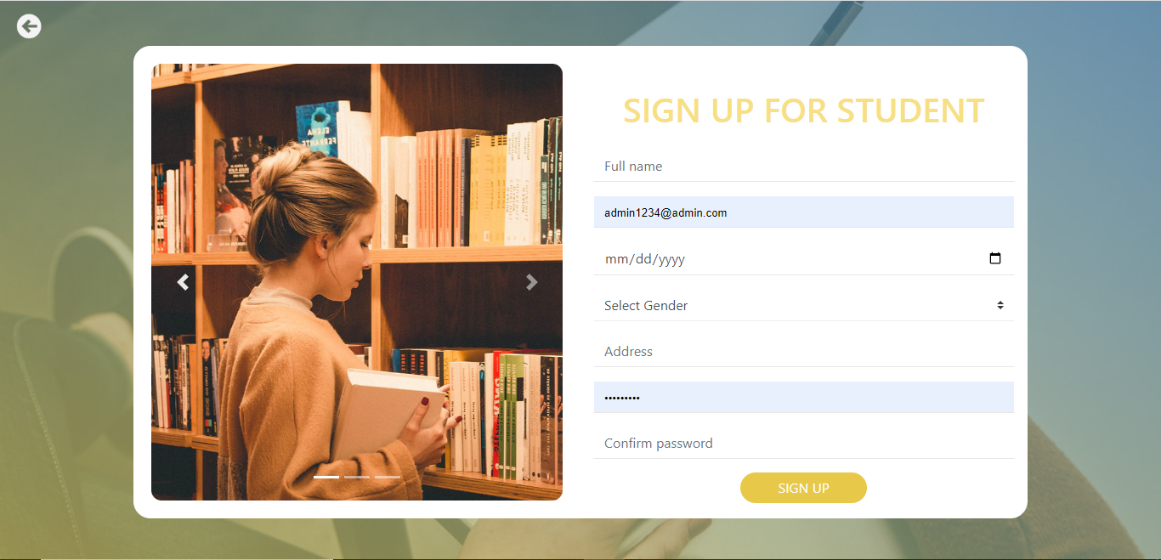
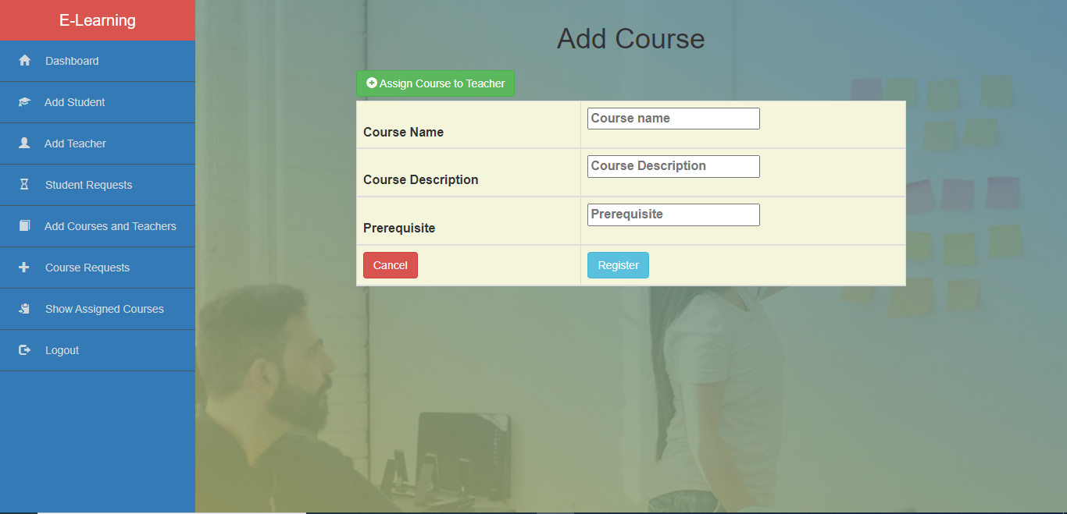
Admin
Database Management
Administrator is overall responsible for management of database of all types
Administrator can remove and edit teachers and students' data
Management of subjects, their descriptions and relation to teachers is responsibility of administrator
Back

Slide 8
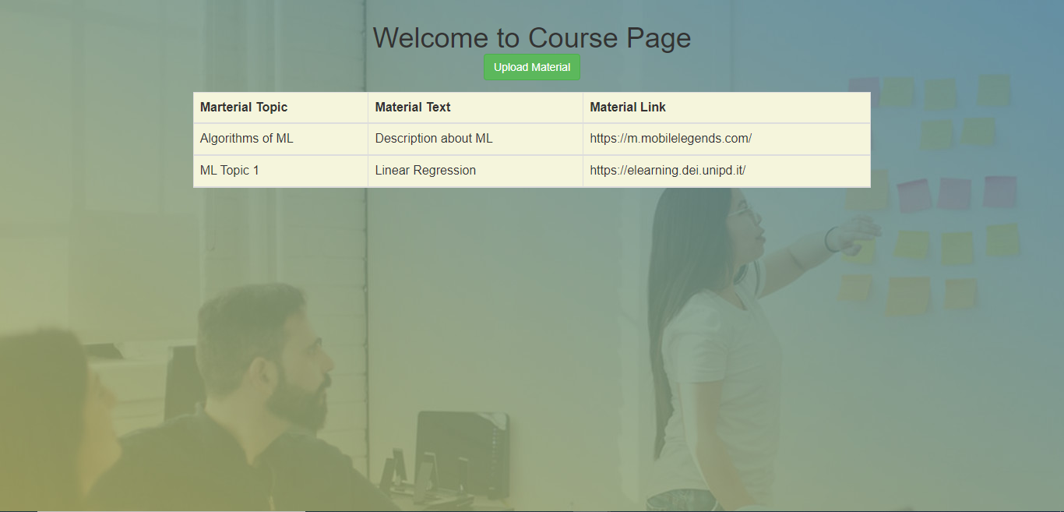
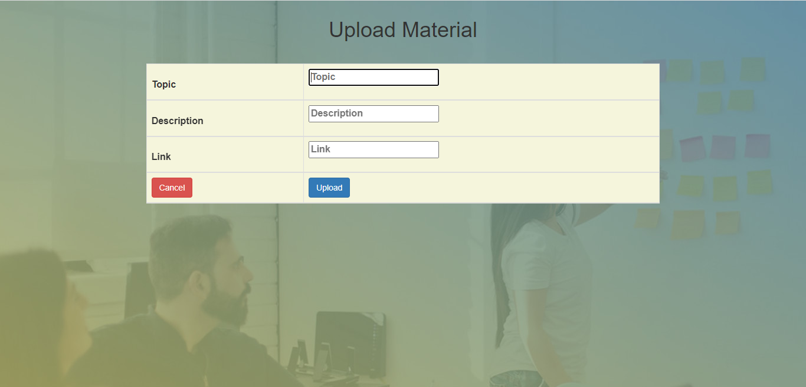
Teacher
Student / Course Management
Courses are assigned to teachers by Administrator
Teachers will be notified when students enroll for the course
Study Material / Query Management
Teacher can add study material to respective subject page
Teacher can add announcements for students enrolled in respective subjects
Teacher can view queries posted by students
Back

Slide 9
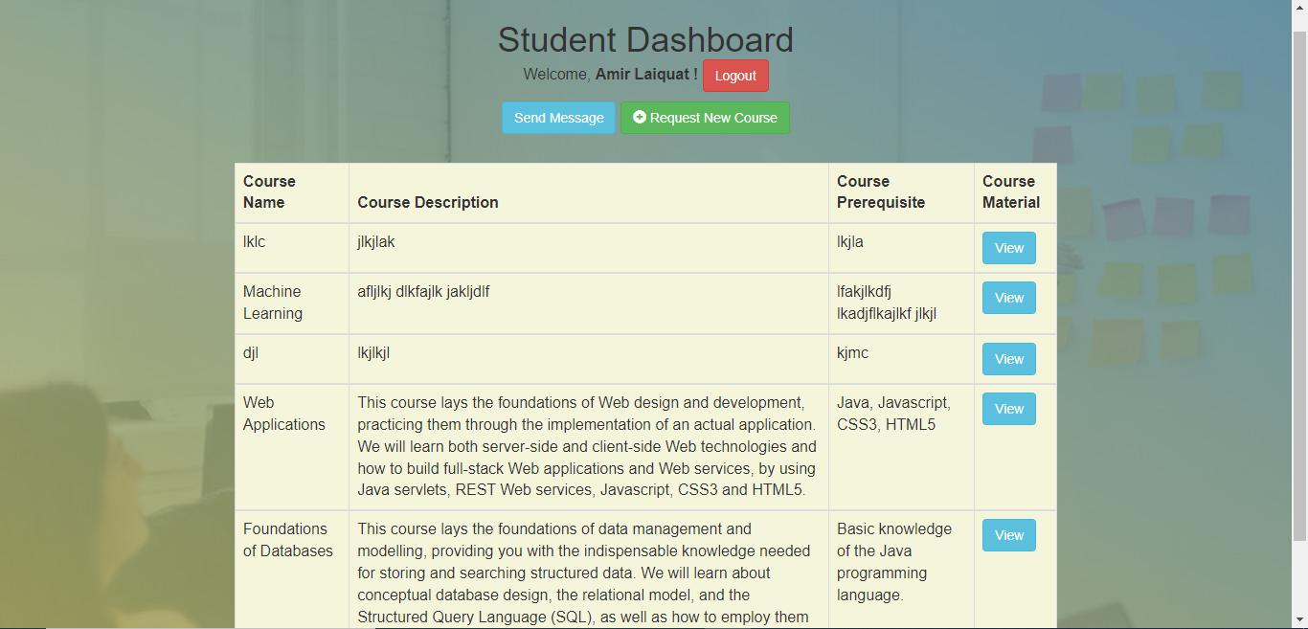
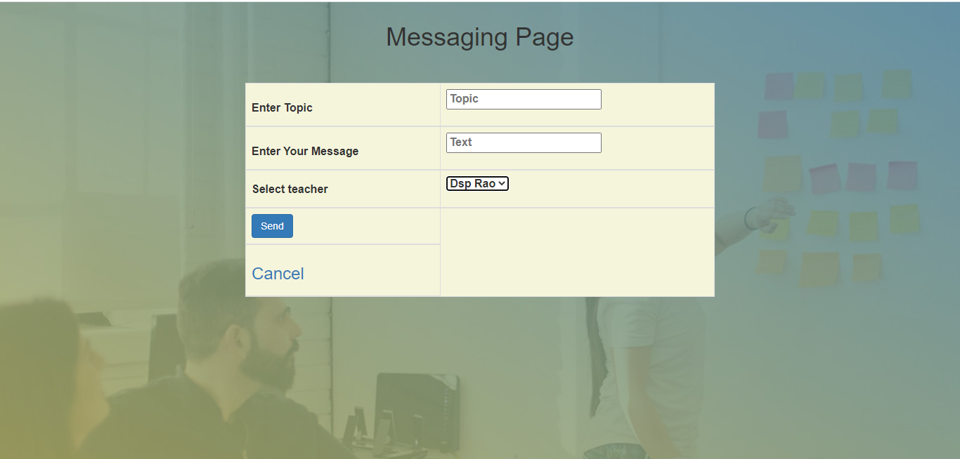
Student
Registration
Students will sign up for the portal which needs to be approved by the admin
Subject Enrolment
After approval, students can sign in and request to enroll in different subjects
Enrolment to subjects will also be approved by the admin
Learning Material
Students will be allowed to access the study material posted by teachers
Query the Teacher
Students can post private messages to teachers
Back

Slide 10
Back End
Front End
DAO
Servlets
Database
Bean
HTML
CSS
JSP
Bootstrap

Slide 11
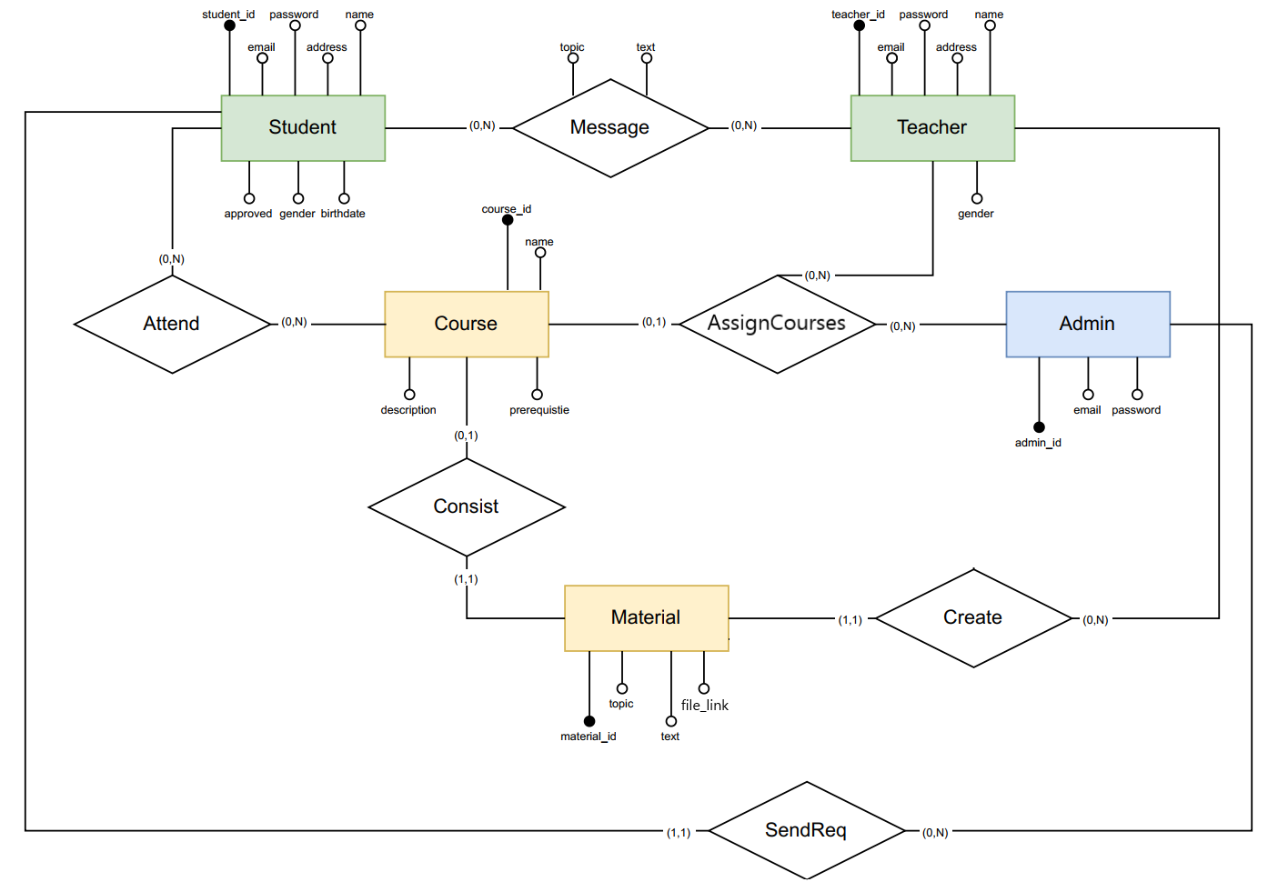
Database
Back

Slide 12
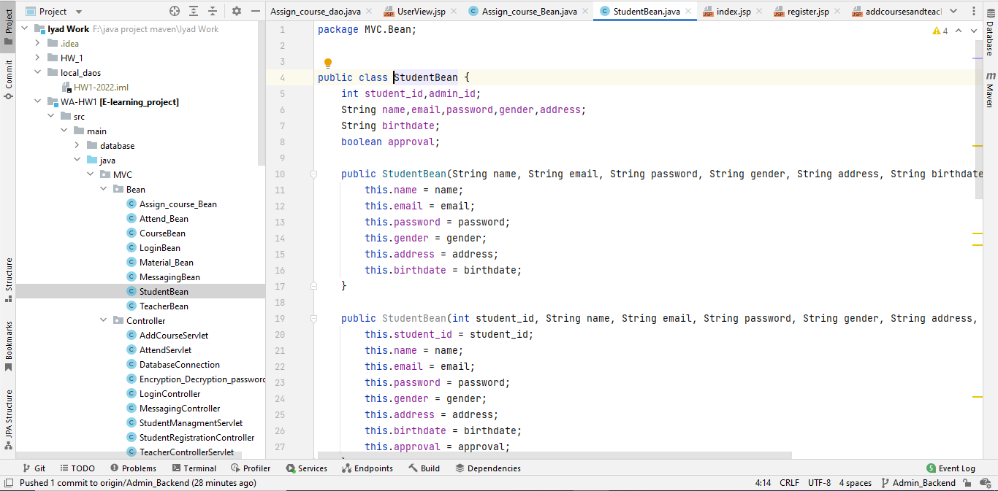
Java Bean
JavaBeans (TM) is a model for designing Java class APIs that allows the use of instances (beans) in various contexts and the use of various tools without writing Java code explicitly.
Major beans used in our project consist of
Student Bean
Teacher Bean
Material Bean
Courses Bean
Back

Slide 13
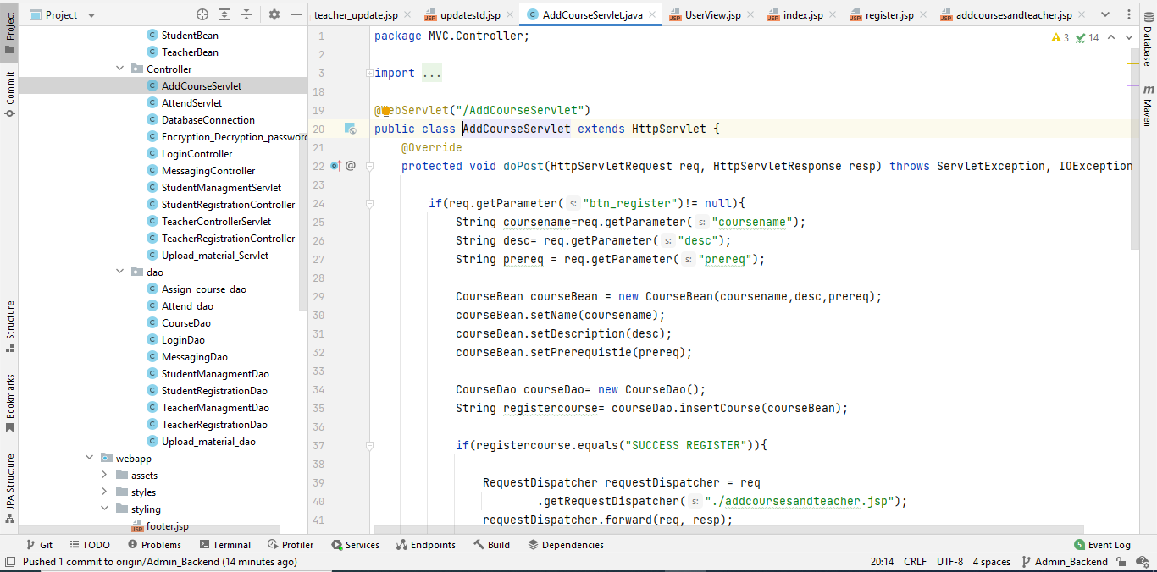
SERVLETS
Servlets are the Java programs that run on the Java-enabled web server or application server. They are used to handle the requests obtained from the web server, process the request, produce the response, then send a response back to the web server.
Major Servlets used in our project are
Login Servlet
Student Management Servlet
Teacher Controller Servlet
Course Management Servlet
Back

Slide 14
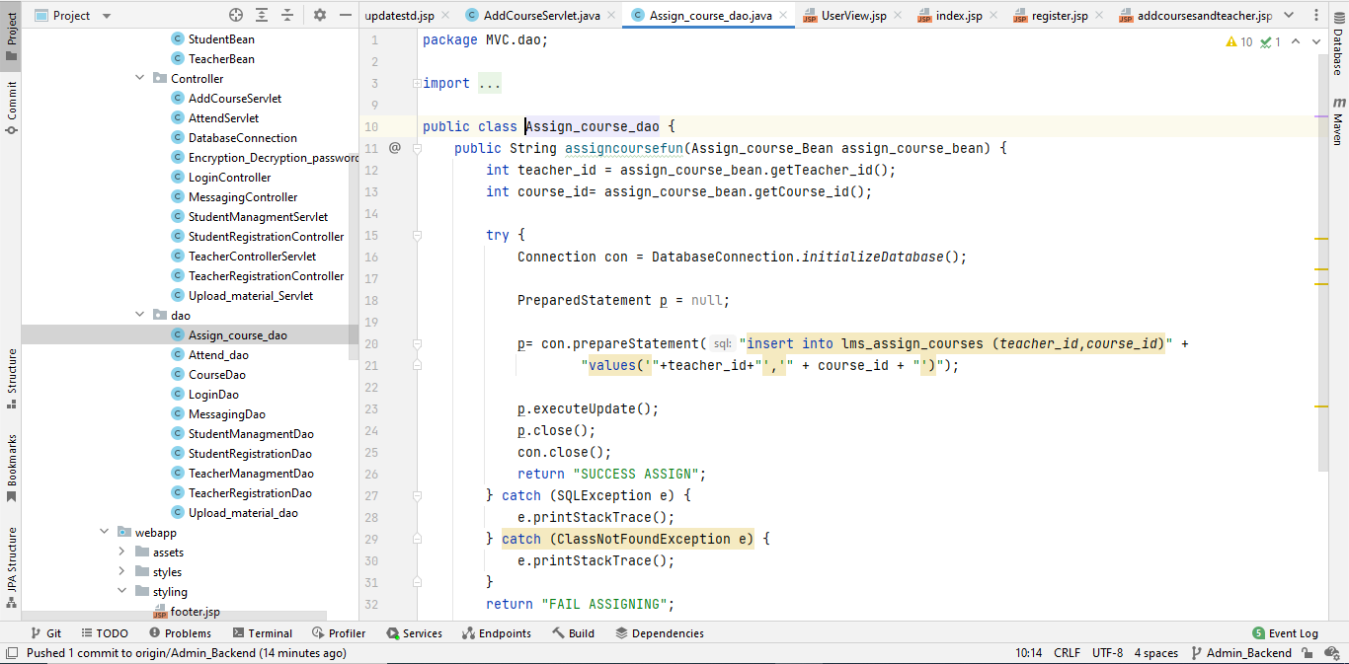
DAO
The Data Access Object (DAO) pattern is a structural pattern that allows us to isolate the application/business layer from the persistence layer (usually a relational database but could be any other persistence mechanism) using an abstract API.
DAOs used in our project consist of
Login DAO
Teacher Management DAO
Student Management DAO
Upload / Update Material DAO
Back

Slide 15



FRONT END
Bootstrap is a collection of free tools for creating sites and applications for the Web. It contains design patterns based on HTML and CSS, both for typography and for the various components of the interface, such as forms, buttons and navigation, as well as some optional JavaScript extensions.
CSS, or Cascading Style Sheets, is a language used to program the graphic rendering of documents written in a markup language, such as HTML and XML. CSS classes are used to specify graphical attributes such as font, size, colour, spacing, border, and position of elements within a web representation.
HTML allows you to semantically describe the structure of a web document through tags, such as identifying a section of text as a header, paragraph, list, link, quote, or other element. HTML is therefore the backbone of web pages: on this structure you can add graphic changes,
Back

Slide 16
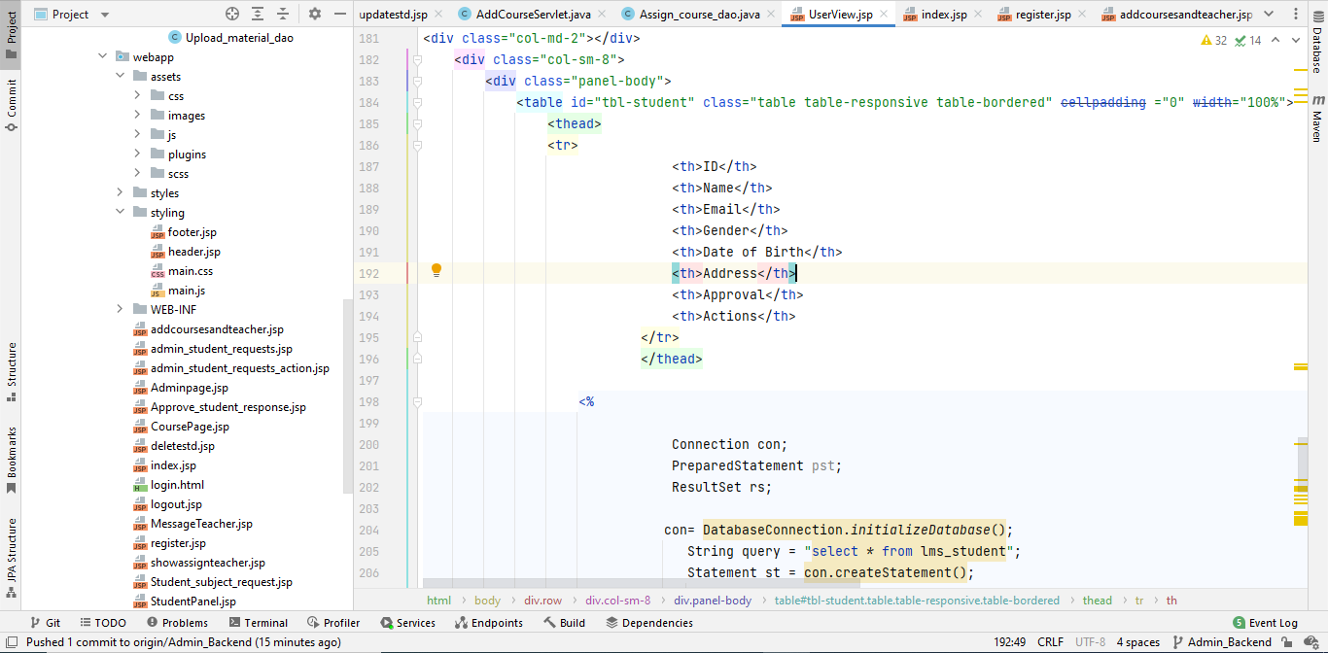
JSP
JSP is a flexible and cross-platform language capable of generating dynamic server-side pages using Java syntax.
Major JSP classes used in our project are
Index
Login
Admin Dashboard
Teachers Portal
Student Portal
Back

Slide 17
Conclusion
Overall, we have much more beans, servlets and DAOs and here we presented the major ones. All other functionalities can be observed in demo.
With increasing technologies, interactivity in educational domain is very much needed. LMS system presented to you is a full product for deployment in any educational institution.

Slide 18
Questions & Answers

